Slide 1


AI StudyMate AI-Based Personalized Study Assistant

Slide 2
AI StudyMate
An Artificial Intelligence Based Personalized Study Assistant
Link : AI StudyMate
Presented By: Shaffa Alure TY B.Sc Computer Science
St. Mira's College for Girls, Pune

Slide 3
* Introduction
Education requires students to manage large amounts of study material.
Reading lengthy documents and preparing notes manually consumes time.
AI can assist students by automatically analyzing content and generating learning resources.
AI StudyMate provides:
✅ AI Chat Assistance ✅ PDF Summarization ✅ MCQ Generation ✅ Quiz Creation ✅ Flashcard Generation ✅ Downloadable Notes

Slide 4
* Problem Statement
Problem Statement:
Students face difficulties in:
Understanding large study documents.
Creating revision notes manually.
Preparing practice questions.
Revising before examinations.
Need:
An intelligent system that can automatically convert study materials into useful learning resources.

Slide 5
* Objectives
The main objectives are:
Develop an AI-powered study assistant.
Provide interactive AI learning support.
Automatically summarize study content.
Generate MCQs and quizzes.
Create flashcards for revision.
Improve student learning efficiency.

Slide 6
*Existing System vs Proposed System
Existing System | AI StudyMate
Manual note preparation | Automatic notes generation
Time consuming | Faster learning
Fixed learning content | AI-generated personalized content
No interactive support | AI chatbot assistance
Manual quiz creation | Automatic quiz generation

Slide 7
* Proposed System
AI StudyMate Solution
AI StudyMate allows students to:
Upload study PDFs.
Extract educational content.
Process content using AI.
Generate learning materials.
Interact with AI chatbot.

Slide 8
System Architecture
PDF Processing Workflow
Document Analysis Process
User
|
↓
Frontend Interface
|
↓
FastAPI Backend
|
---------------------
| |
PDF Processing Gemini AI API
| |
---------------------
|
↓
Generated Output
PDF Upload
|
↓
Text Extraction
|
↓
Content Processing
|
↓
Gemini AI Analysis
|
↓
Generated Summary / Quiz

Slide 9

* Technologies Used
Frontend
HTML
CSS
JavaScript
Bootstrap
Backend
Python
FastAPI
Artificial Intelligence
Google Gemini API
Tools
Docker
GitHub
Render Deployment

Slide 10
* System Modules
1. AI Chat Module
Answers student queries.
Provides explanations.
2. PDF Processing Module
Upload documents.
Extract text content.
3. Summary Generator : Creates concise notes.
4. Quiz Generator : Generates practice questions.
5. Flashcard Generator : Creates revision cards.
6. PDF Download Module : Saves generated content.

Slide 11
* AI Chat Module
AI Assistant
Features:
User enters question.
Backend sends request to Gemini AI.
AI generates response.
Benefits:
Instant doubt solving.
Interactive learning.
24/7 availability.

Slide 12
* AI Content Generation
Generated Learning Resources
AI StudyMate generates:
Summary
Converts lengthy documents into short notes.
MCQs
Creates:,Questions ,Options ,Correct answers
Flashcards
Creates:,Question → Answer format
Quiz
Tests student knowledge.

Slide 13
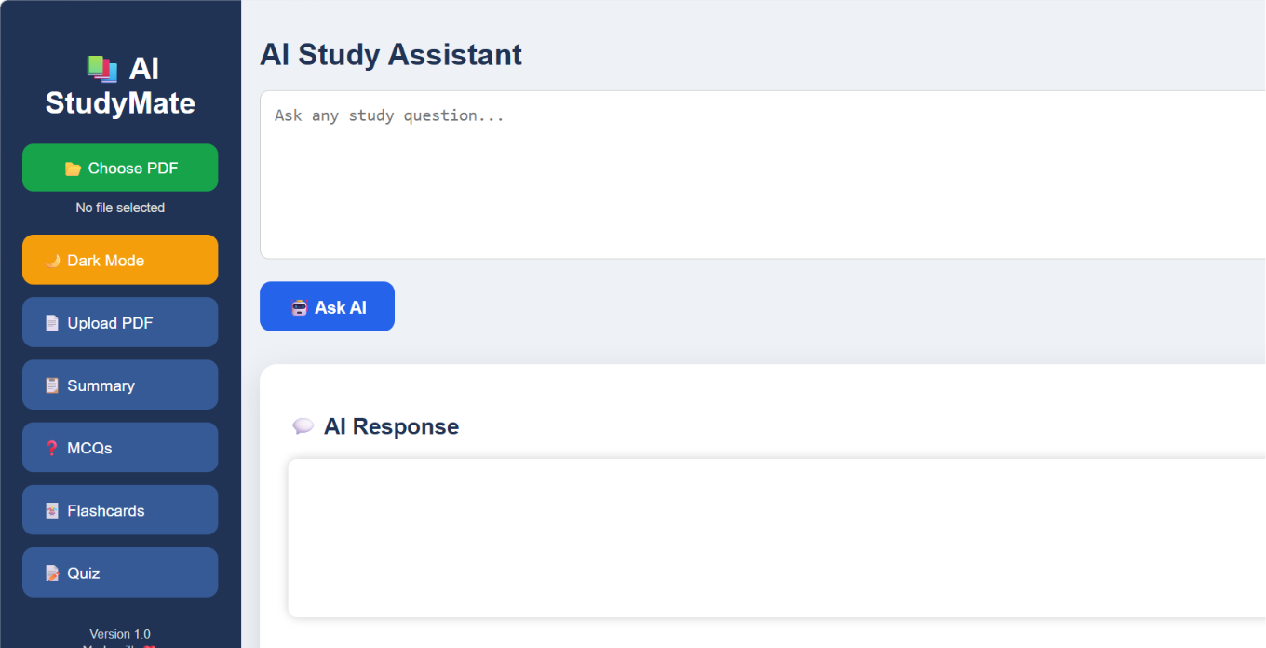
* User Interface
Include:
Home page
Upload section
Chat interface
Summary output
Quiz page
Dark mode

Slide 14
* System Modules
1. AI Chat Module
Answers student queries.
Provides explanations.
2. PDF Processing Module
Upload documents.
Extract text content.
3. Summary Generator : Creates concise notes.
4. Quiz Generator : Generates practice questions.
5. Flashcard Generator : Creates revision cards.
6. PDF Download Module : Saves generated content.

Slide 15
* Backend Implementation
FastAPI Backend
Responsibilities:
API handling
File processing
AI communication
Response generation
Backend Structure:
Backend
|
├── main.py
├── requirements.txt
├── Dockerfile
└── Environment Config

Slide 16
* Docker Implementation
Containerization
Docker packages:
Application code
Dependencies
Runtime environment
Application :
Advantages:
Easy deployment
Environment consistency
Workflow:
Code
↓
Dockerfile
↓
Docker Image
↓
Container
↓

Slide 17
* Deployment
Cloud Deployment
Platform:
Render
Deployment Process:
GitHub Repository
|
↓
Render
|
↓
Docker Build & Deploy
|
↓
Public Application URL

Slide 18
* Testing Results
Feature | Status
AI Chat | ✅ Successful
PDF Upload | ✅ Successful
Summary Generation | ✅ Successful
MCQ Generation | ✅ Successful
Flashcards | ✅ Successful
Quiz Generation | ✅ Successful
PDF Download | ✅ Successful
Dark Mode | ✅ Successful

Slide 19
* Advantages
Advantages
✔ Reduces study time ✔ Automatic learning material generation ✔ Interactive AI support ✔ Easy accessibility ✔ Personalized learning experience ✔ Modern AI-based education solution

Slide 20
* Future Scope
Future Enhancements
Mobile application.
Voice-based AI tutor.
User accounts.
Learning progress tracking.
Personalized study plans.
Multi-language learning support.

Slide 21
* Conclusion
Conclusion
AI StudyMate demonstrates how Artificial Intelligence can improve education by providing automated learning assistance.
The system successfully integrates:
Web Development
Artificial Intelligence
Natural Language Processing
Cloud Deployment
It helps students learn faster, revise effectively, and access personalized educational support.

Slide 22
Thank you

